Slide 1
Go Threw the Topics
Markdown language used in README.md file of gotHub like HTML
Combining dbutil.fs with python
V- 26 last few min.

Slide 2
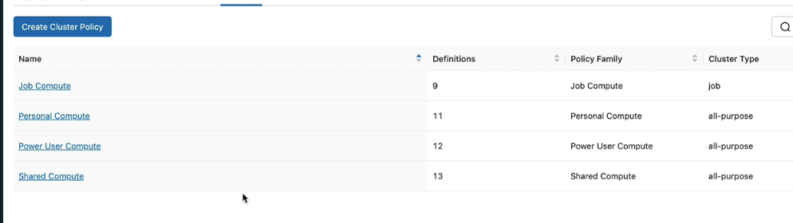
Cluster Policy [V-9]
Creating Cluster Policy
Databricks > Compute (sidebar) > Policy
Also, we have the option to create another Policy, based on one of these policies available and override
certain attributes.
So that makes it easier to create a Policy.
There are four Cluster policies available.
They are default policies created by Databricks for us.
If one of them suits our needs, we can simply use that.

Slide 3
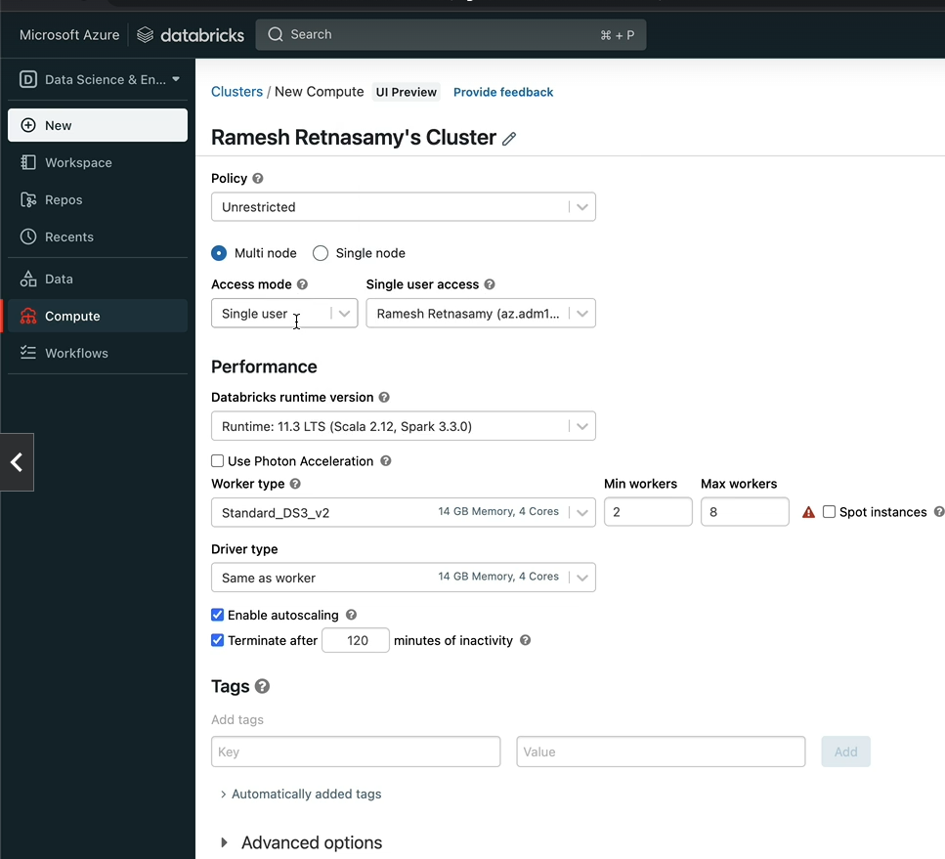
Creating Cluster Policy from scratch.
Let's define our requirement first.
Databricks > compute > All perpous Compute > Create Compute
When we select the Policy as Unrestricted, we are presented with the user interface with all the options
available to create a Cluster.
Let's say, I'm an administrator and I have a number of students taking the course that you are taking,
and I want to restrict them to create Clusters, limiting to only the needs of this project.
That means we only allow for a Single node cluster to be created.
That means, we'll pre-select Single node and we don't let them choose Multi node at all.

Slide 4
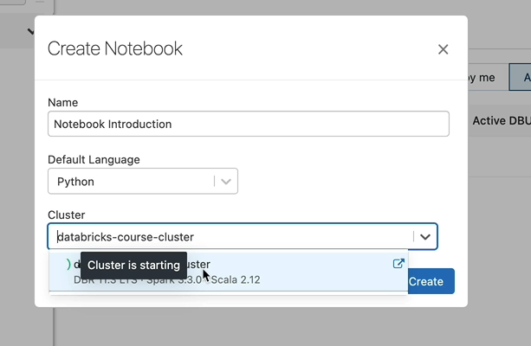
Creating Notebook
Databricks > workspace(sidebar) > workspace > users > mohdsameer20203097@gmail.com > Create (rightSide) >folder > new folder → name as databricks-Course
Then visit new folder(databricks-course)> Create > Notebook
we need to attach the notebook to a cluster in order to be able to execute the commands. We only have one cluster and that's currently starting, so let's choose that and click Create.

Slide 5
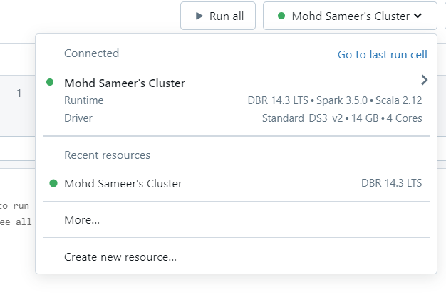
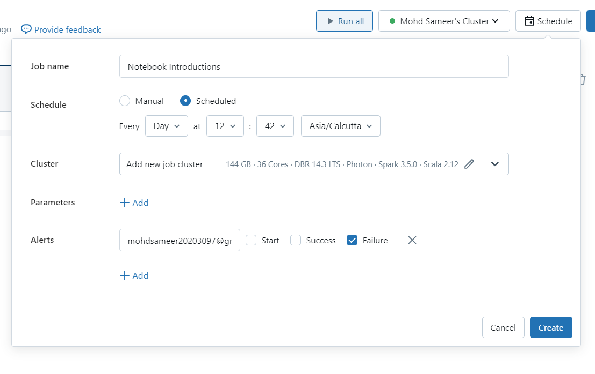
Over the top right You can click on the Run all button here, to run all the commands or the cells within this notebook.
And you can see the Cluster that's attached to the notebook here, and the green circle here indicates that the Cluster is up and running.
You can Detach, Restart or Terminate the cluster if you wanted to, and also you can attach to a different cluster if you wanted to from here.
And the next button here gives you the option to schedule this notebook to run at regular intervals by creating a Databricks Job.

Slide 6
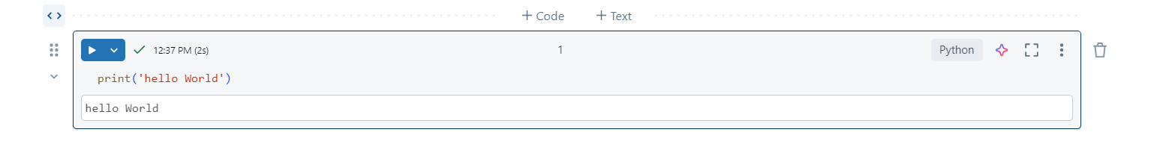
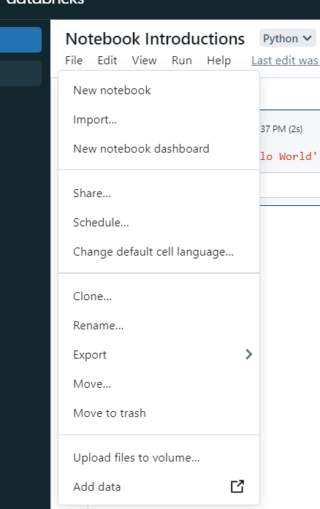
As we said, a Notebook is a collection of cells that run commands on a Databricks Cluster.
As you can see, we've got one cell here.
You can add new cells by clicking the plus button here.
Clone creates the copy of notebook.
Let's click Clone and call the new notebook as Notebooks Copy.
So what that does is it's going to clone this notebook and create a duplicate of that.
And you have the choice to put the notebook into whichever folder you want it to.

Slide 7
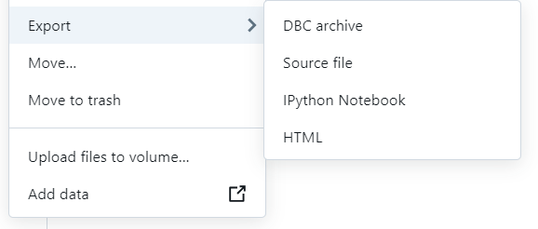
You can export the notebook in any of these four format specified here.
1) If you're not familiar with the DBC file format, that's the Databricks Binary File format, which allows us to export not only individual notebooks, you can also export the entire folder and also it can contain any types of files in it.
And you can then import that DBC file into another Databricks workspace or within the same Databricks workspace into another folder later.
So that's really really useful, if you're working with Databricks.
2) If you choose the Source file format, each notebook will be exported as separate files in Source file format.
For example, . py for this notebook, as it's a Python Notebook.
If you had a SQL notebook, you will have a file with the extension of .SQL.
3) IPython will export the file in IPython format.
But as you can imagine, it's only applicable for notebooks with Python as the default language.
4) Finally, HTML will export as a single HTML file for each of the notebook.

Slide 8
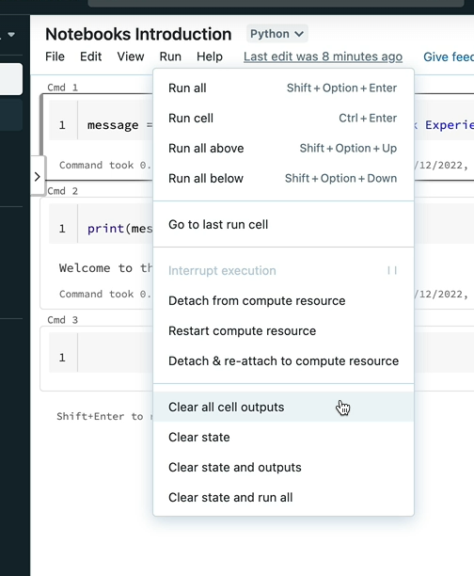
Clear the state and the outputs of this notebooks as you wish.
Clearing the state basically clears all the variables.
So if I now click on the Clear state, that's going to clear all the variables in this notebook as it
you also have the option to clear the state and run everything.

Slide 9
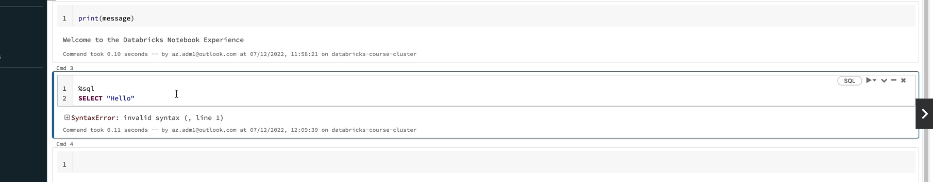
Hare % SQL (any language name) is used to change the programming language in the same notebook despite the default language.
This can be also done by selecting a different language from the right side of the cell.
We can easily execute all the cells using the run-all button despite them having different languages.
This is a cool feature within Databricks notebooks.
This allows us to have one notebook with multiple languages, and that's really powerful.
Apart from being able to switch between these four languages, Databricks also offers few auxiliary
magic commands, which are quite handy.
Markdown guide cheat-sheet
https://www.markdownguide.org/cheat-sheet/#basic-synta/

Slide 10
Magic Commands
V - 23
1) % sql; %python; %r; %scala →used to change the cell language other than default language.
You cannot use two different languages in the same cell in a Databricks notebook. Each cell can only contain code in a single language. You need to split the code into separate cells for each language.
2) %md → by using this cell can be used as a marked down language
3) %fs → file system magic command,
ls → to list down all filles.
That's basically listed the folders within the databricks root folder.
But if you wanted to see the contents of this folder for example, you would just do ls /databricks-datasets,
%fs
ls /folderName (eg. ls /databricks-datasets) → But when you run this command, databricks basically called the dbutils package called dbutils.fs to get the results.
You can directly call the dbutils.fs package, instead to list these files. dbutils.fs package offers a number of methods to perform file system operations and ls is one of them.
dbutils.fs(‘filderName’) ( eg. dbutils.fs(‘/’) → list all the folders and files within the root folder.)
Note: why we would want to use the dbutils package, instead of the Magic Command %fs. The answer is dbutils package provides a greater flexibility, as it can be combined with other native languages like Python, Scala or R.
4) %sh → Shell command.
ps → list all prosses that running in the cluster.

Slide 11
As I said, this is really powerful.
For example, in your pipeline, if you find a package in Python to do the first task and then another
library in Scala to do the next task, you can still have both of them in one notebook.
You don't have to convert them to the same language or have different notebooks to execute them, which
is really cool.

Slide 12
dbutils.fs Package
So that's what you're saying in a tabular format on the %fs ls and here when you access the
dbutils.fs.ls(‘root_pagth’) you see the same contents, but you've got a list which is a Python list as an output.
I mentioned this before, but this folder here databricks-datasets contains a number of publicly available datasets, which you can use in your pet projects. So as a Data Engineer you might want to develop your own projects and if you want to do that in Databricks, this is a really good place for you to look at.
For example, if you want to see some Covid related data, you can just go into the COVID folder and that's got a number of files that you can use in your projects.
I would encourage you to look at this data if you are interested in doing any pet projects.

Slide 13
dbutils.fs Package
We use dbutils package instead of the magic command %fs.
Because dbutils package provides a greater flexibility, as it can be combined with other native languages like Python, Scala or R.
For example, If I want to go through the list of files here and perform some additional operations, I simply have to write a for loop to iterate through this list, and add any additional manipulations as I need.
we've quite easily combined dbutils with Python to make it more powerful.
Use %fs magic command if you are doing some ad-hoc queries, and use the dbutils.fs package if you are doing something programmatically.
You can do the same with Scala and R, but you can’t do this with SQL.
dbutils.help() → hat's listed all the utilities available. But please note that some are in experimental mode and some are in preview.
dbutils.fs.help() → This will list all things about fsutils command and also mount
butils.fs.help(‘ls’) → this will give descriptions about ls command with example

Slide 14
How to import DBFS file in Databricks
Databricks > workspace > chose folder where you wants to import (I Chose home dir.) > right click > select Import
Databricks proprietary file format called DBC
I have made My Project Solution available for you in both Databricks proprietary file format called DBC and also Python and SQL file formats with the .py and .SQL extensions.
Databricks allows us to export an entire folder or even a workspace in a databricks proprietary archive file format called DBC.
It's really useful because this allows us to have one large file for a backup of an entire project, rather than many individual files for each of the notebooks.
You can then import this DBC file into another workspace to recreate the project folder.

Slide 15
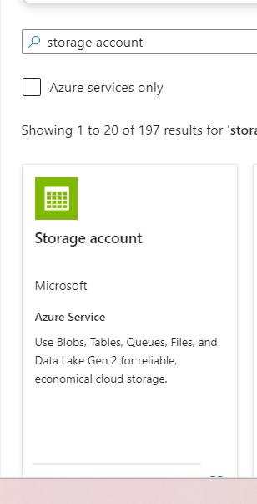

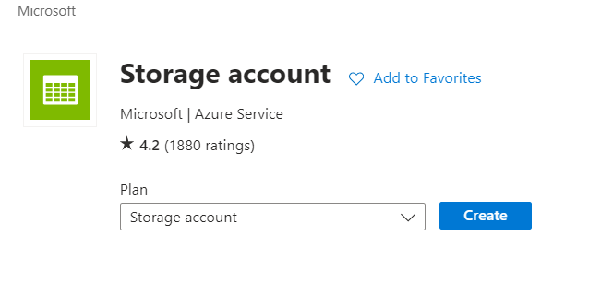
Creating storage Account
V -27
Go to Azure Portal
Left sidebar drop down menu
+ Create resource > search >storage account >
Click on Create

Slide 16
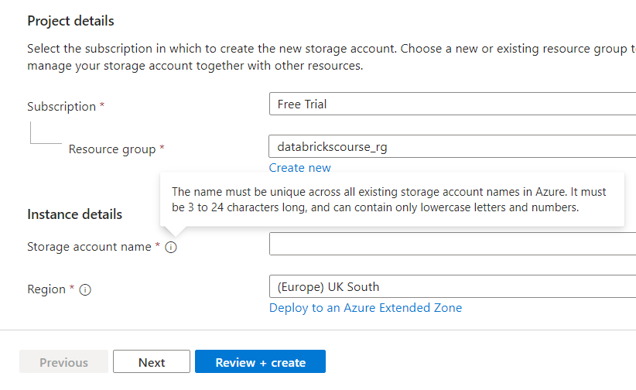
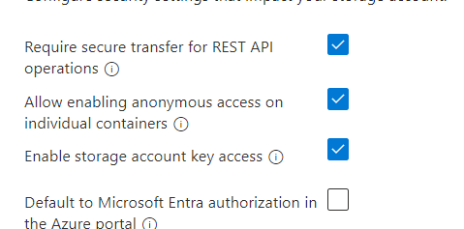
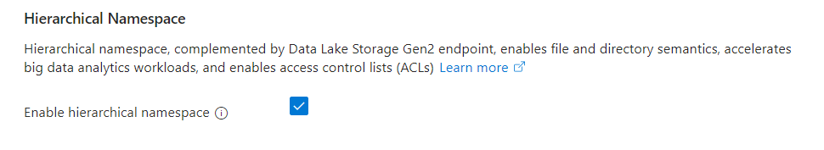
Storage account name: formula1dl
dl → stands for data lake
Region: UK south
Redundancy: LRS
Performance: Standard
Then click on next button
By default, the option to enable a hierarchical namespace is left Unticked.
If we don't check this checkbox here, we'll end up creating a Standard Azure Blob Storage.
But we want to create a Data Lake Storage Gen2 account.
So let's tick that.
Make sure that you have a check on Hieraxhical Name Space

Slide 17
If you are wondering about the difference between the Standard Storage and the Data Lake Storage, they both use the same object storage underneath, but the Data Lake Storage comes with a hierarchical namespace, which helps with folder structures and fine grained access control to the data files.
You can leave everything else as default and click through to Networking.
After creating Storage account click on Go to resource
From here you can manage the account

Slide 18
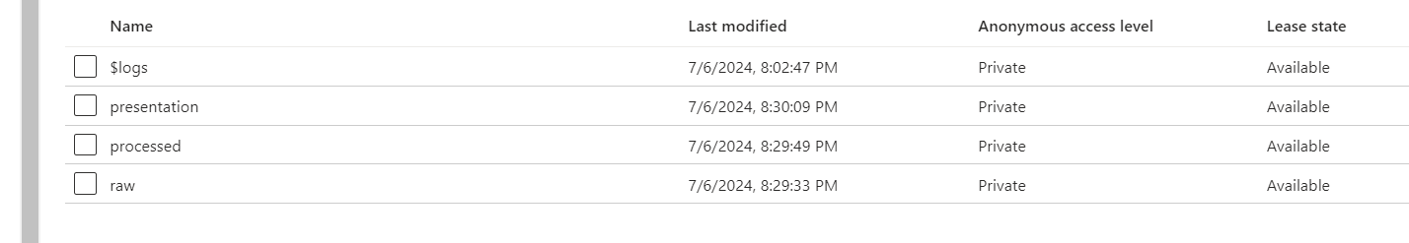
Creating containers
Azure Databricks URL
Formula1dlhamza> data storage (sidebar) > containers > +container
If you're not familiar with the word Container, it's synonymous with folders or directories.
They are just containers to hold your files, grouped together into one place.
For our project, we are going to have three containers called raw, processed and presentation.
If you are familiar with the Databricks Medallion Architecture, this is synonymous with Bronze, Silver and Gold.
Now upload the circuit.csv file on the demo container, so you can use it within Azure.
So this UI allows you to interact with the file as well.
it's very similar to working with any other file system storage, such as in Windows
or in Linux.
But there are some limitations with this web user interface.
Microsoft offers a desktop tool which works better, and we'll look at that in the next lesson.

Slide 19
Creating Azure storage Storage Browser
Azure Databricks URL
Formula1dlhamza > storage browser ( sidebar) > Download Azure Storage Explorer
Or Click on the link: https://azure.microsoft.com/en-us/products/storage/storage-explorer/
Aftet downloading and installing the Explorer signed in with Azure.

Slide 20
Section 9: Formula1 Project
FAE → Federation Internationale de l’Automobile
Association Stablished in 1947
Formula1 → Inetiay rule was that the capacity of engine is only 2.5 feet capacity and naturally asparit.

